Slide 1
#starterfor10k
Jackie Killeen, Director for Scotland

Slide 2

Many small pieces
Notes:
Disclaimer – young children – bit of a theme to the rest of these slides. Have seen the Lego Movie – no singing.
Prep – many funders in Scotland, different sizes, working in different geographies, funding different issues. Up to 2,000 individual trusts, foundations and funds (heavy caveat). Don’t know all of these, but of the 80 or so funders who work together through the SFF and SG, over half have and operate at least one dedicated small grants programme.
Big Lottery Fund – thousands of groups and communities supported every year through AfA, IiI, Communities & Families and currently 2014 Communities and Celebrate.
Last year: 2,494 small grants to a total value of £13.8m (compared to around 390 large grants totalling £70m+)
When I look into a monthly portfolio of AfA for example, I may typically find: lunch clubs for older people; allotments; support for people with dementia; playgroups; after-school clubs; advocacy; foodbanks; recycling; bee-keeping; arts and crafts.
Not to torture this metaphor but these individual small pieces....

Slide 3

Connect
together
Notes:
... to make up the richness and diversity of community life.
Like Lego, sometimes it’s easy to step on these small pieces. But unlike Lego, these pieces can be a bit fragile, and easy to inadvertently damage. One of the messages we have as a group of funders is that these pieces and this activity are often important to local people, and have a value that may be difficult to quantify, and shouldn’t therefore be overlooked.
A group that is successful in getting a grant to run an evening or weekend project for young people may not be highly visible on the radar of the local authority, but it connects people together, volunteers and participants, and a change of use or increase in rent for the building the group meets in might mean that they’re no longer able to continue with what they’re doing.
Equally, funders need to be mindful and proportionate: if we require those volunteers to spend too much time reporting to us on outcomes and ‘demonstrating impact’ they might very reasonably decide that they have other ways of spending their Tuesday nights.
Fact is: small grants can enable citizens to remain active and connected – and we understand from our CMO and growing research how important that is – for not a lot of money.

Slide 4
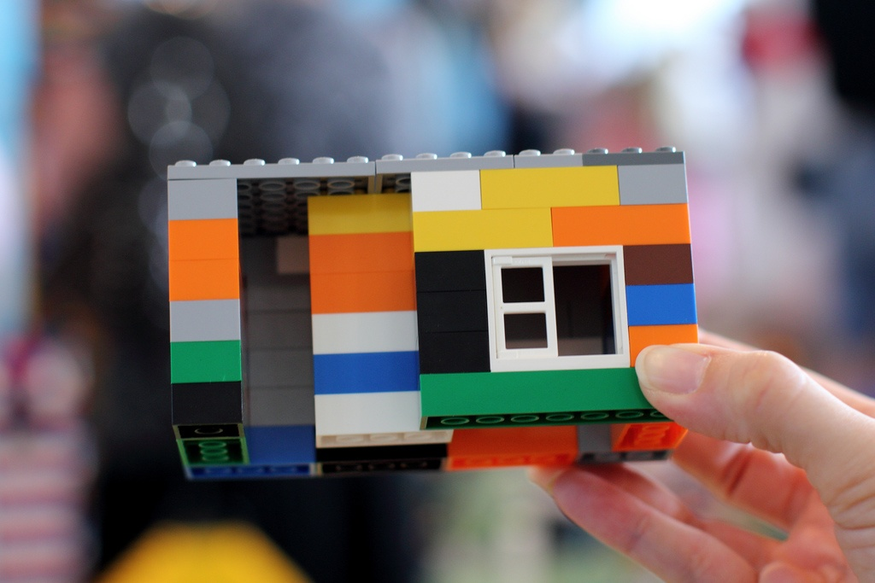
Starting
small
Notes:
[Head from Mr Swinney about Burnfoot] – shows how applying for and successfully holding a small grant can be both the sign and the – sorry – first building blocks of ambitions.
We see many examples in what we fund – actually, sometimes people tell us we don’t make enough of these evolutionary stories, so here is a brief example.
Message recently from org who got first AfA grant 3 years ago to fund recovery activity for ppl trying to move on from addiction. First grant paid for mix of activity to improve social skills and build confidence, using gym sessions and healthy cooking, food hygiene and first aid. A second AfA grant helped them devleop a tutor-led art group, offereing therapeutic activity to service users.
As a result of this, the art group have now formed their own charity and have been going strong for over a year.

Slide 5
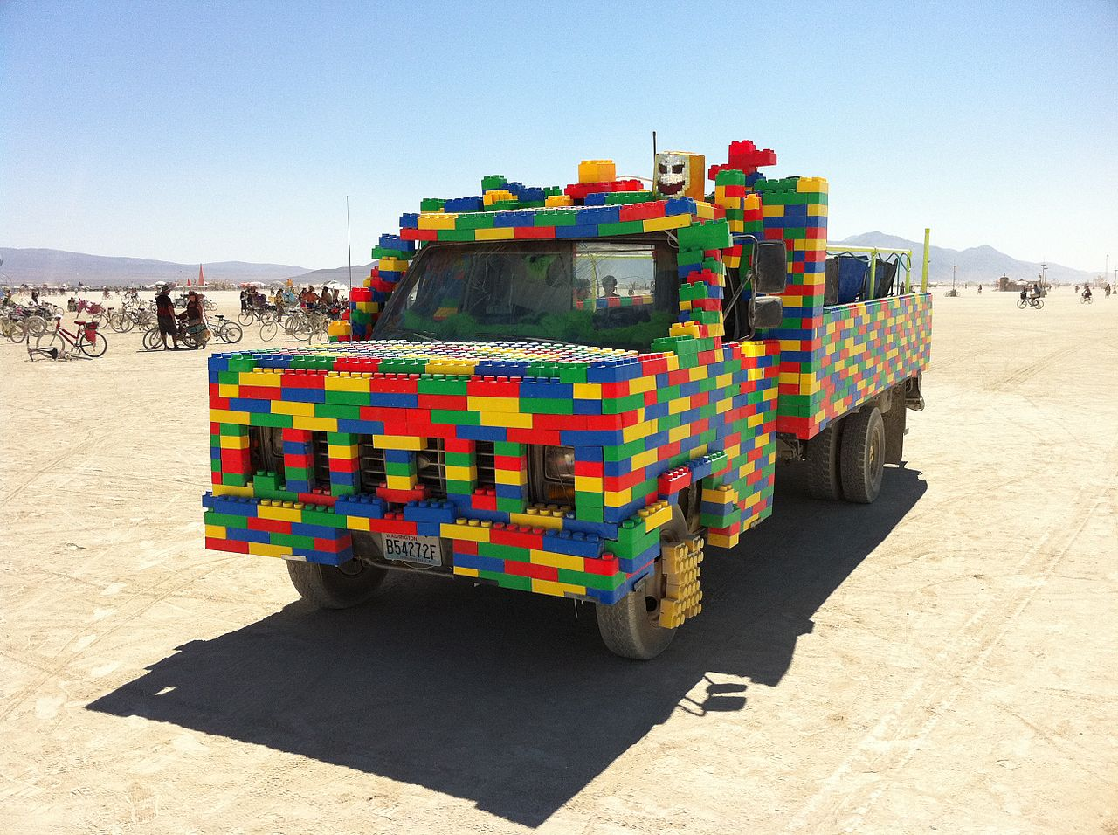
Building something
BIG
Notes:
The original project has developed into a bigger endeavour, receiving large grant funding from us and funds and support from others. Our correspondent said: “I’m not aware if anyone is threading these applications together and appreciating what a help they have been to our groups, and how they have helped us to deliver some pretty groundbreaking approaches to helping those with addiction issues to recover.”
[this is pretty excessive use of Lego btw, but it is pretty heat resistant!]

Slide 6
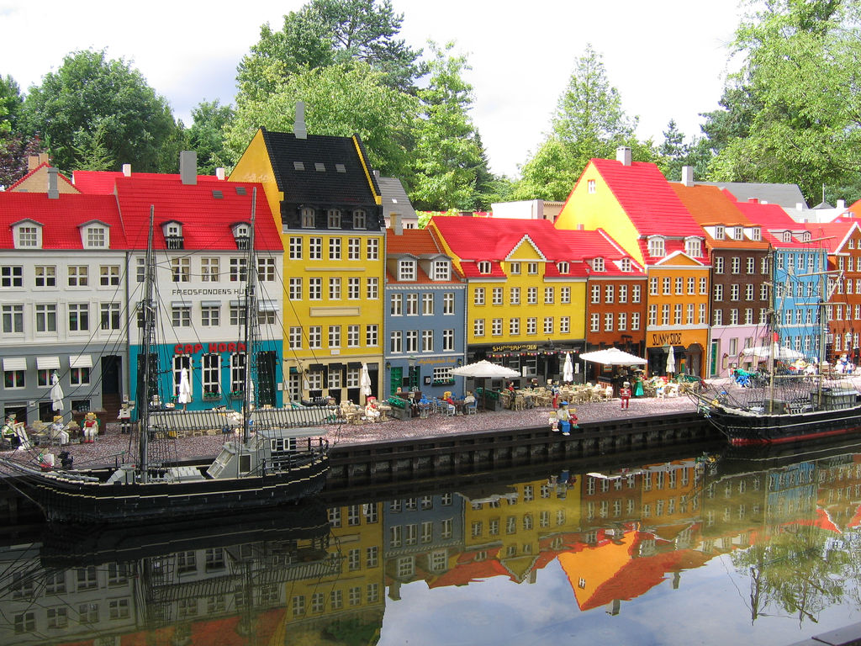
Building
communities
Notes:
Whether a small grant is the start of a bigger journey, or a resource that enables goodwill, social connection and voluntary action to keep going at a local level, or a particular need or problem to be tackeled, it has a really valuable role in building and sustaining communities.
We very regularly look at the spread of our funding across the country – how are different areas doing, are they applying to us, are they successful, what are they applying for. Who is applying for those funds – local groups and/or bigger national or regional organisations?
Monitoring the uptake of small grants can be a bit of a temperature check of the health of local community life – if we identify areas with a very low uptake of small grants, we investigate further to find out why. Sometimes it might be because other, local funders are amply meeting that need – but sometimes it’s because there aren’t many active groups, or capacity is very low. And that’s when we try to work with partners locally to see what can be done about that.
OPTIONAL BIT ON PREVENTION:
Recently analysed all our grants, of every size, in Scotland from 2006-2013 to understand how much of what we fund is ‘preventative’. What we found was that the majority of small grants are ‘primary prevention’ – upstream funding that helps prevent problems ever arising. By contrast, the majority of large grants support secondary and tertiary prevention – ie, where a problem has already begun to manifest.

Slide 7
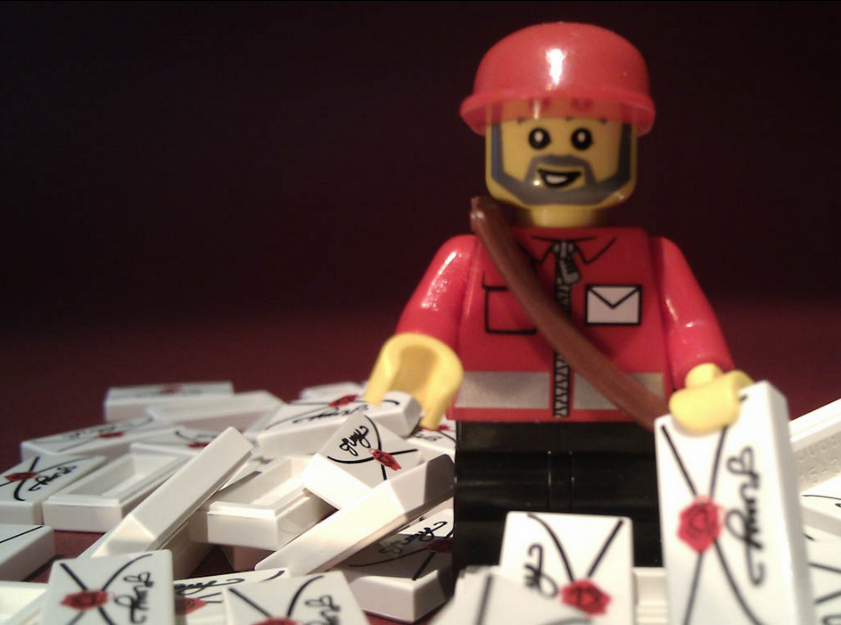
Your voice
Our vision
Notes:
Mentioned earlier that we are staring to look ahead – think about how we should work, who we should work with, how best we can achieve our mission – just starting a conversation.
This is definitely not our official branding, but we do have a dedicated digital platform to help people share their thoughts, and us to collect those thoughts.
www. Biglotteryfund.org.uk/yourvoice
Not the branding but we are basing this conversation around 4 building blocks:
Vibrant Communities: How can we grow social capital and help communities make the most of their assets?
Addressing Disadvantage: What should we be doing to support ppl living in poverty to achieve a better quality of life? How do we address increasing demand for help in demanding times?
Stronger sector: How can we best support the development of a stronger third sector?
Working together: How can we best work with others to make a difference?
You’ll find the link to this conversation on our website – won’t find anyone looking much like this – and we’ll be using events like this and others to try to engage with people also over the next few months.

Slide 8
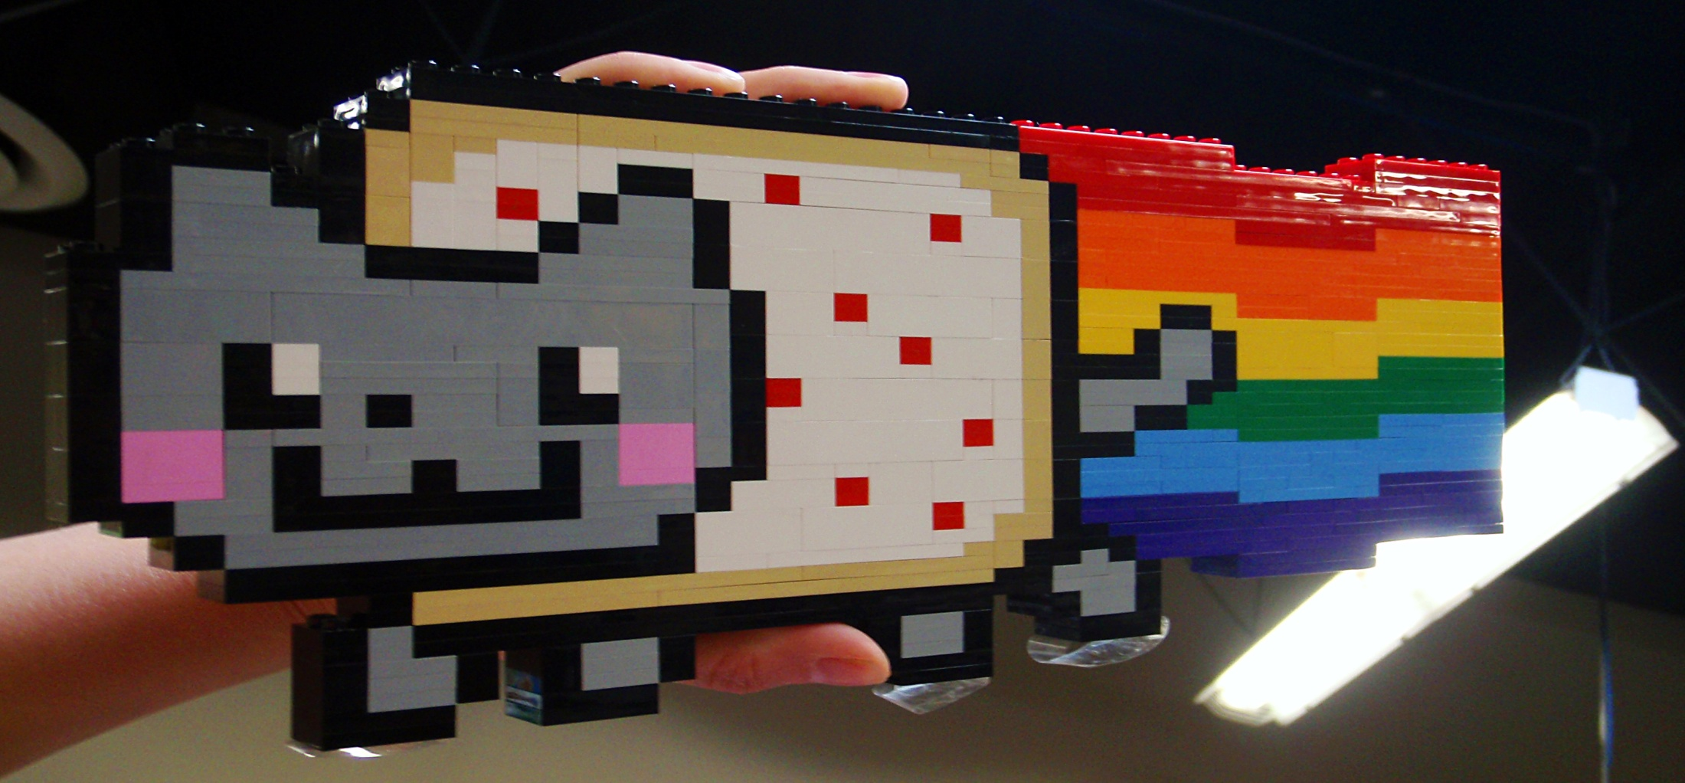
Building something
brilliant!
Notes:
Working in a small country we have a great opportunity to share and work together. To align our efforts and our resources around shared goals, and there are many, many excellent examples of that, from the EYCollaborative to actually the work we as funders try to do together.
Small grants and the work they support in communities can be part of that, if they have visibility at the local level. If they’re on the radar of orgs who have responsibility for decision making, if they’re valued and understood as making a contribution to community life.
Equally – they can create the space and the conditions for something outlandish, unexpected, creative and maybe, brilliant and transformative to get off the ground.
Admittedly, we haven’t funded many – any cat/wall fusion projects, but we have supported different groups coming together for the first time, to develop new services to tackle old and new problems, and they often go on to make connections and creations they never expected at the outset.
Wasn’t allowed to have ‘Unikitty’, the unicorn/kitten hybrid from Lego Move because of copyright - - but you get the idea.
Thank you for listening.

Slide 9
@jackiekilleen
@bigscotland
www.facebook.com/biglotteryfundscotland
www.bigblogscotland.org.uk

